Slide 1
Swisscom Network Analytics Cosmos Bright Lights Network Anomaly Detection
Sharing operational experience in the transition from a Time Series Database to a Real-Time Streaming Processor based system.
thomas.graf@swisscom.com wanting.du@swisscom.com
alex.huang-feng@insa-lyon.fr
vincenzo.riccobene@huawei-partners.com
antonio.roberto@huawei.com
06. March 2024

Slide 2

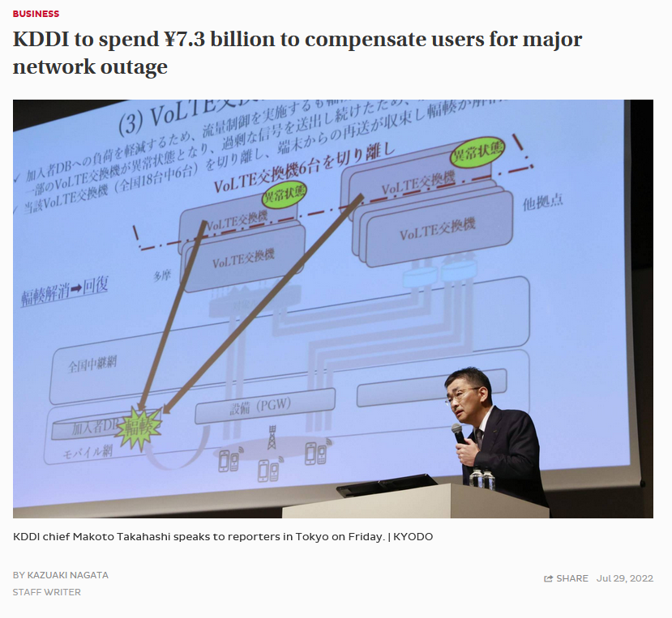

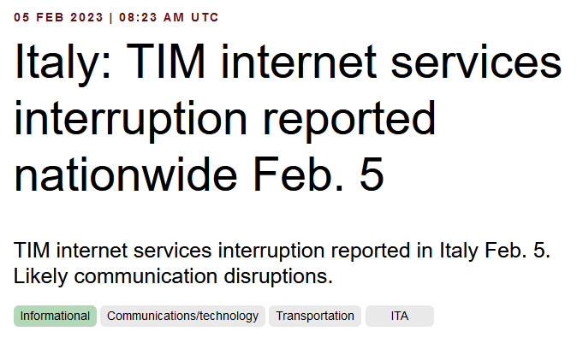


Why to automate monitoring Recognize network incidents faster than humans can
« Customers are always connected, when VPN's changing, regardless due to operational or configurational reasons, network operators are late to react due to missing visibility and automation »

Slide 3




What does Network Anomaly Detection mean Monitor changes
Answers
What changed and when, on which connectivity service, and how does it impact the customers?
Focuses
Provides meaningful connectivity service impact information before customer is aware of and support in root-cause analysis.
Data Mesh
Consumes operational real-time Forwarding Plane, Control Plane and Management Plane metrics and produces analytical alerts.
Direction
From connectivity service to network platform.
Network Anomaly Detection
For VPNs, Network Anomaly Detection constantly monitors and detects any network or device topology changes, along with their associated forwarding consequences for customers as outliers. Notifications are sent to the Network Operation Center before the customer is aware of service disruptions. It offers operational metrics for in-depth analysis, allowing to understand on which platform the problem originates and facilitates problem resolution.

Slide 4
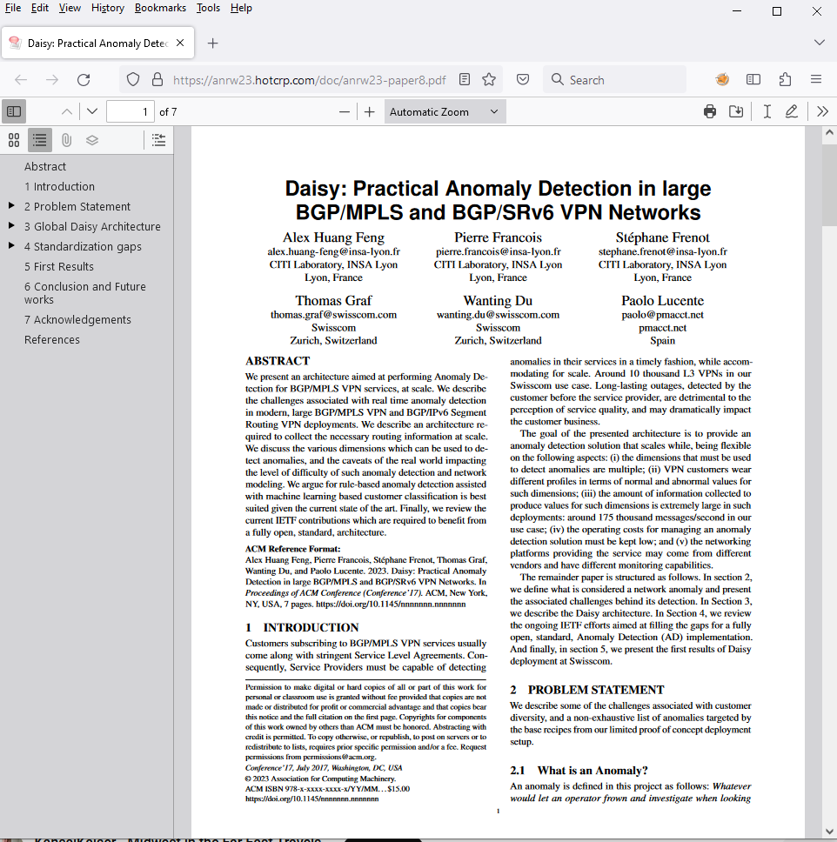
Presented in ANRW 2023 At IETF 117 San Francisco
« A more detailing paper will be submitted soon to IEEE Transactions on Network and Service Management»

Slide 5
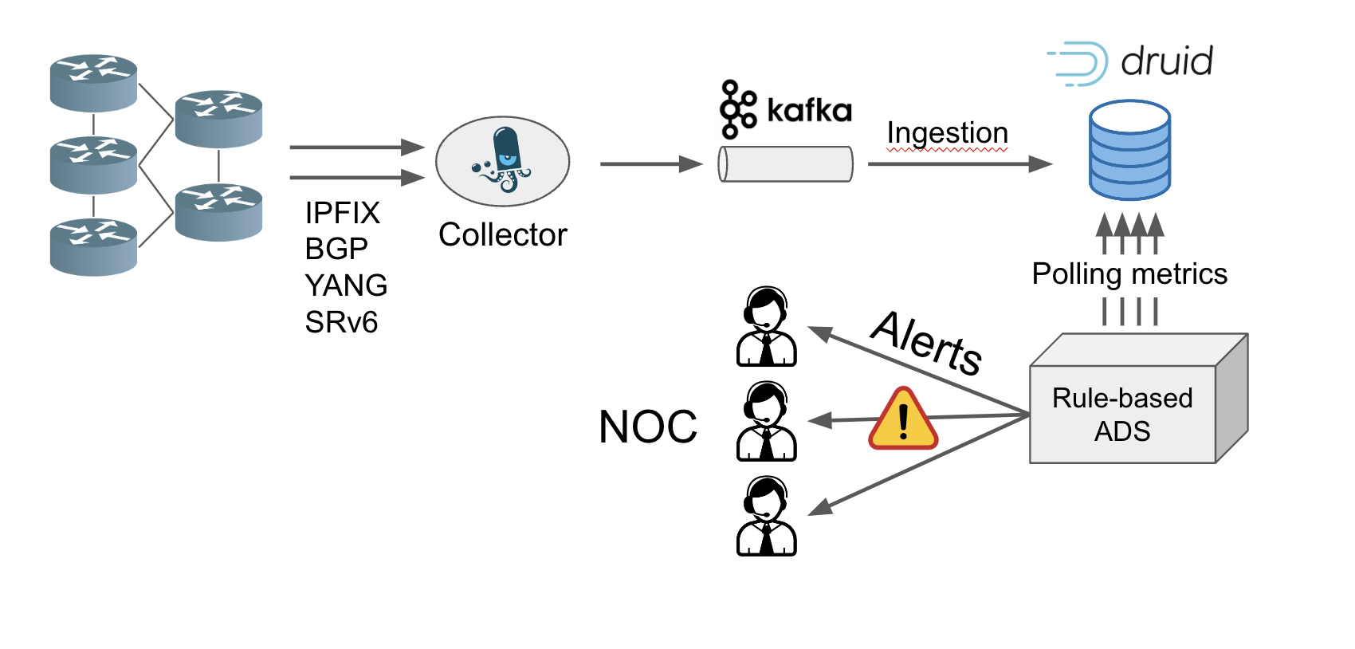
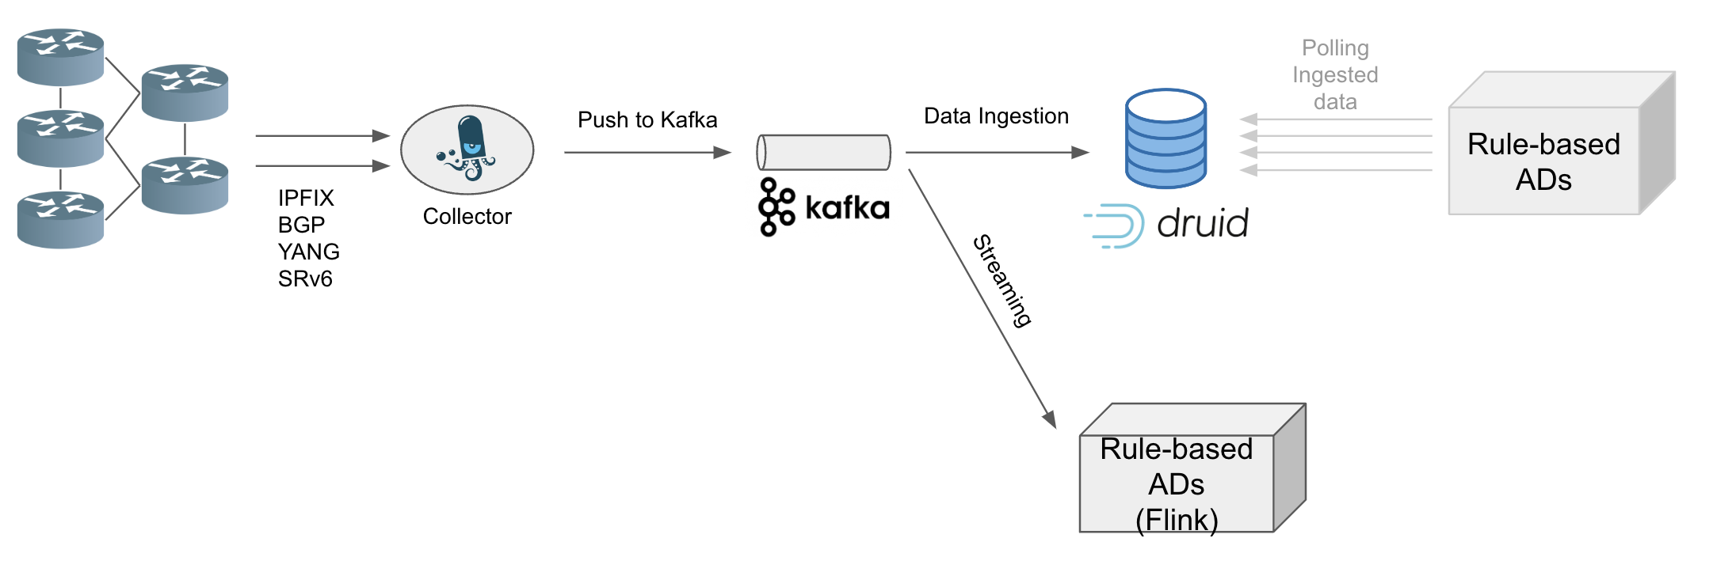
Overwiew of Cosmos Bright Lights Architecture Comparison
A rule-based approach that actively monitors and promptly detects L3 BGP-MPLS VPN [RFC 4364] anomalies in near real-time. It summarizes and correlates Network Telemetry [RFC 9232] collected metrics from 3 different network planes to identify the possible root.
→
Polling based system architecture with Apache Druid (V0)
Stream based system architecture with Apache Flink (V1)

Slide 6
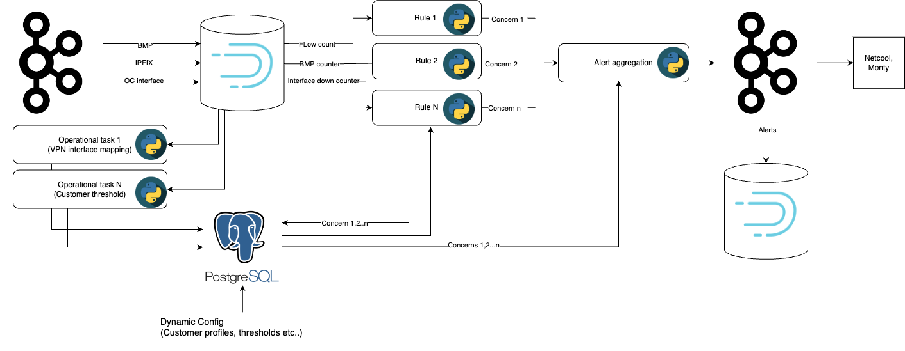
Tech Stack of Cosmos Bright Lights V0 with Apache Druid Time Series Database

Slide 7
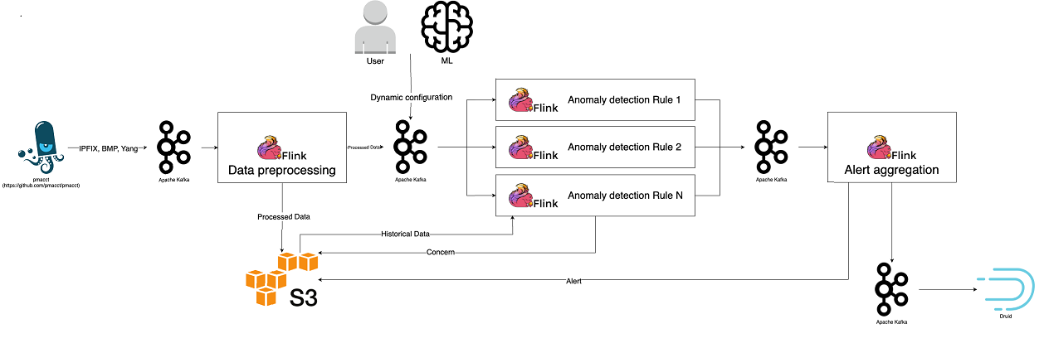
Tech Stack of Cosmos Bright Lights V1 with Apache Flink Real-Time Streaming Processor

Slide 8
What to monitor Which operational metrics to verify
« Network Telemetry (RFC 9232) describes how to collect data from all 3 network planes efficiently »
Forwarding Plane: Verify wherever traffic is missing (dropped outside the monitored domain), being dropped with IE89 forwardingStatus or transport session count spiked due to retransmissions with IE3 deltaFlowCount.
Control Plane: Verify wherever routing topology changes or peering state changes occurred with BMP message type route-monitoring and peer-down.
Management Plane: Verify wherever interface state changes occurred with YANG Push collected interface metrics.

Slide 9
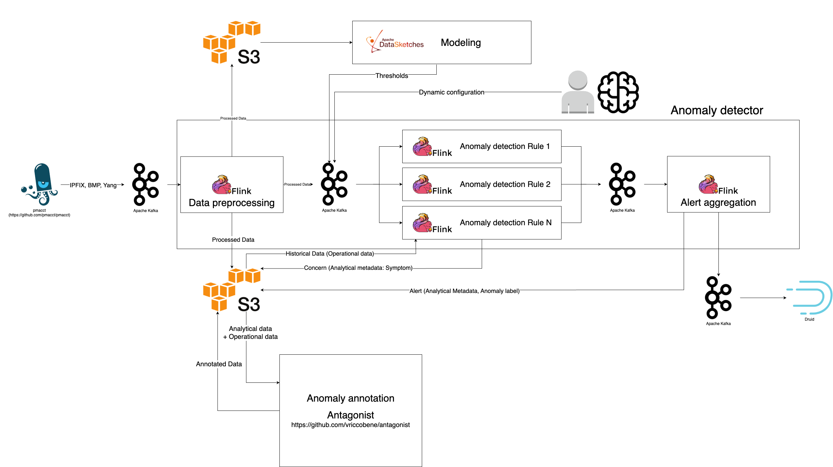
Next Steps - Semantic Metadata Augmentation Apache Flink Real-Time Streaming Processor Integration

